Slide 1
Samarpan Website
Ecological Awareness
1996 to 2018

Slide 2
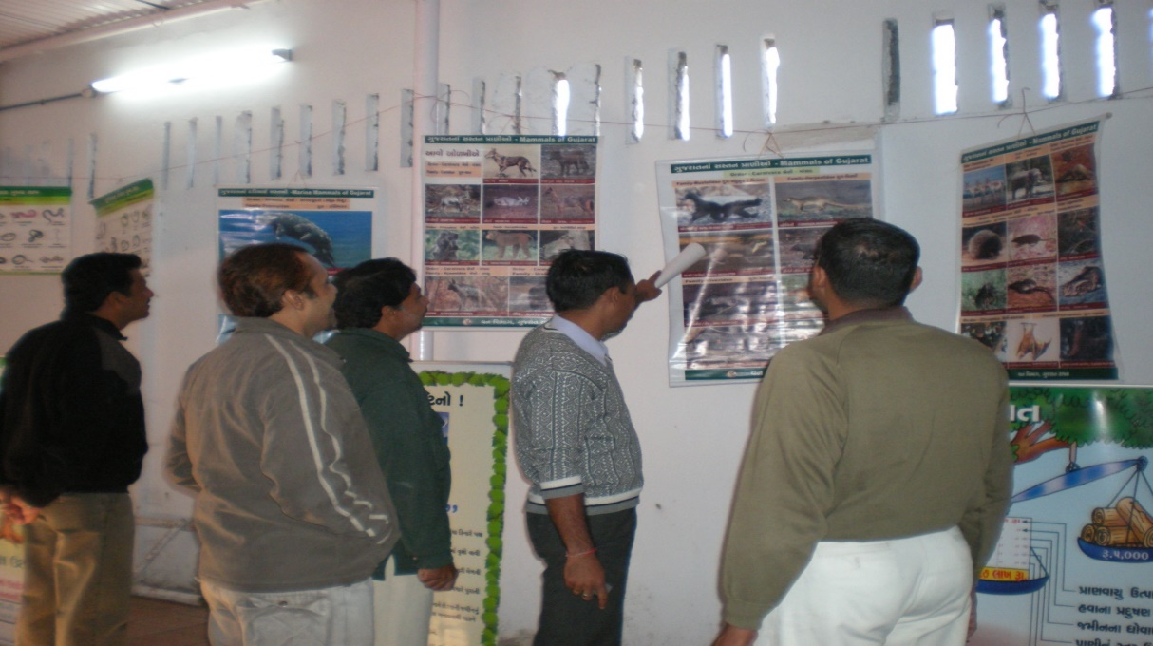
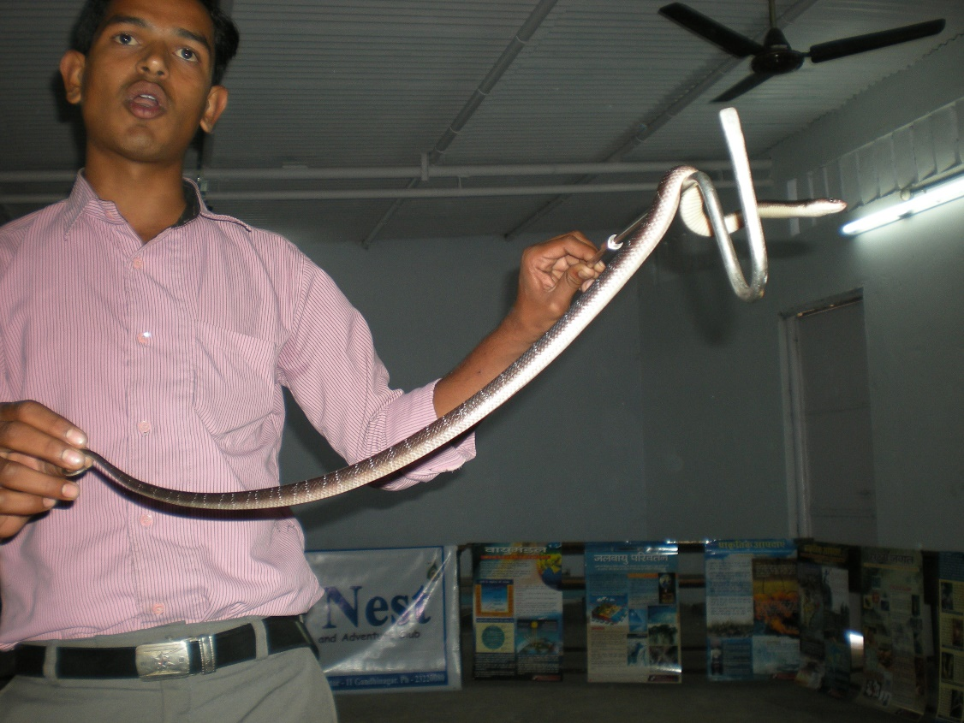
Ecological Awareness Programme

