Slide 1
Samarpan Website
N.S.S. Camp Inauguration

Slide 2
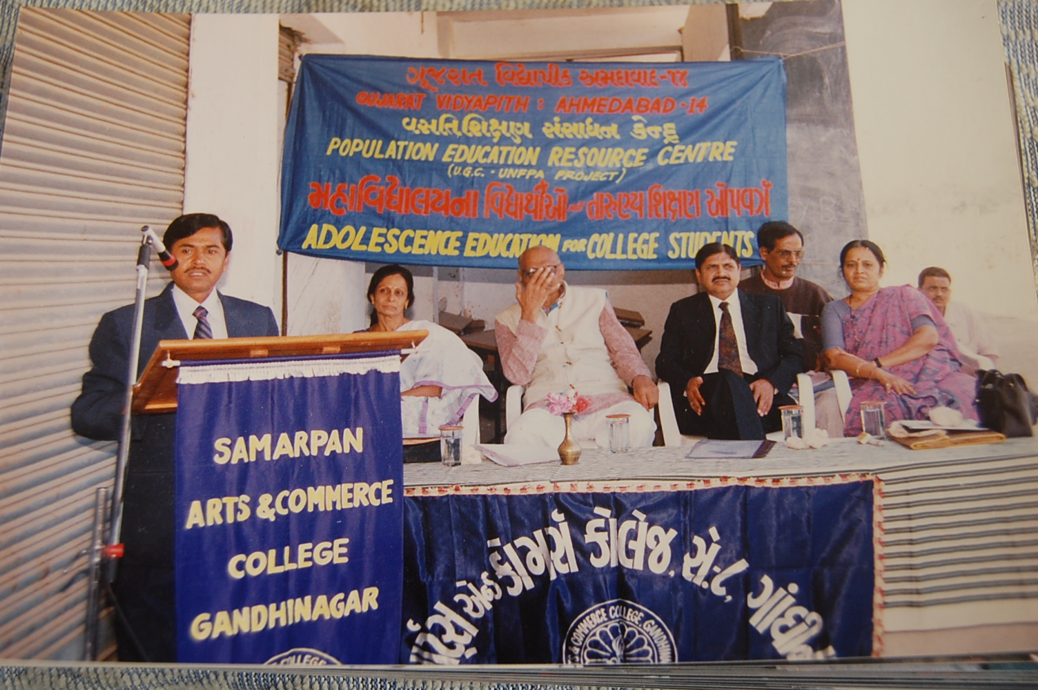
N.S.S. Camp Inauguration
Notes:
At Balva
3. At Samarpan College
4. At Sanali

Slide 3
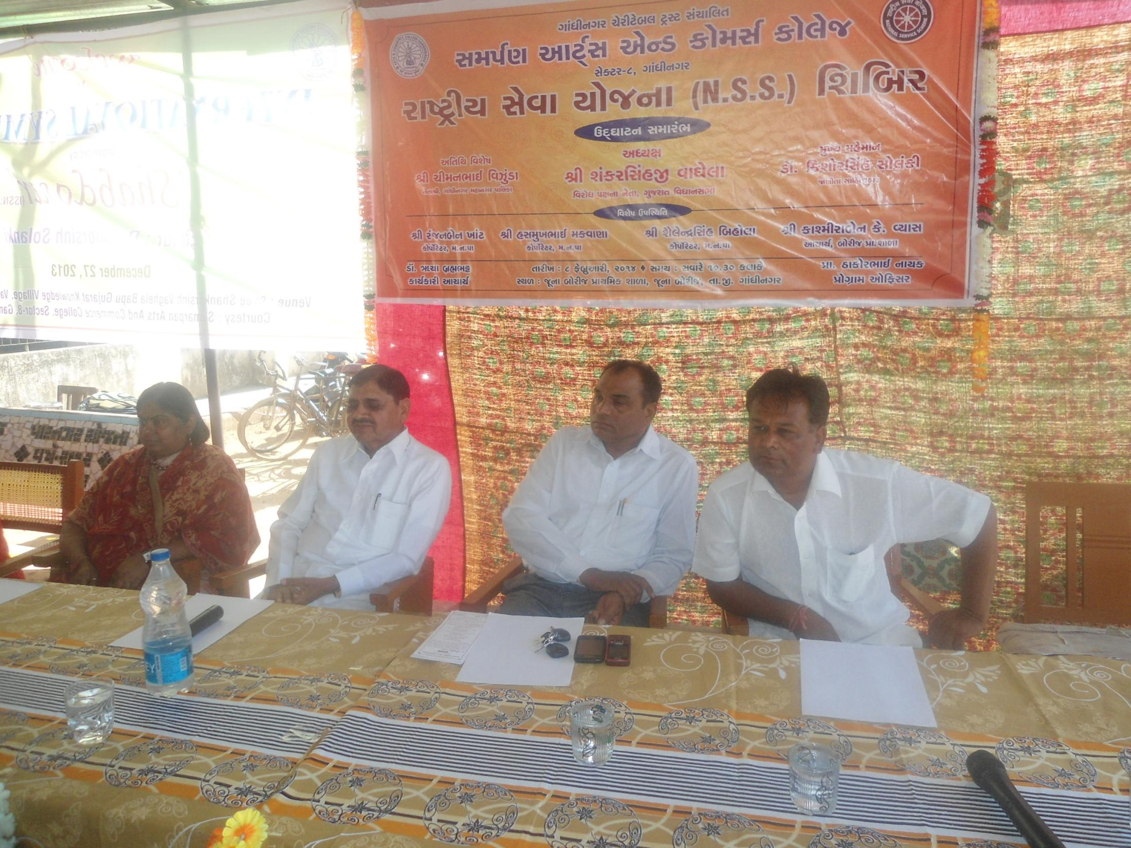
N.S.S. Camp Inauguration
Notes:
At Jasor
At Indroda

