Slide 1
Samarpan Website
Health Checkup camps
AIDS Awareness Drive
1996 - 2018

Slide 2
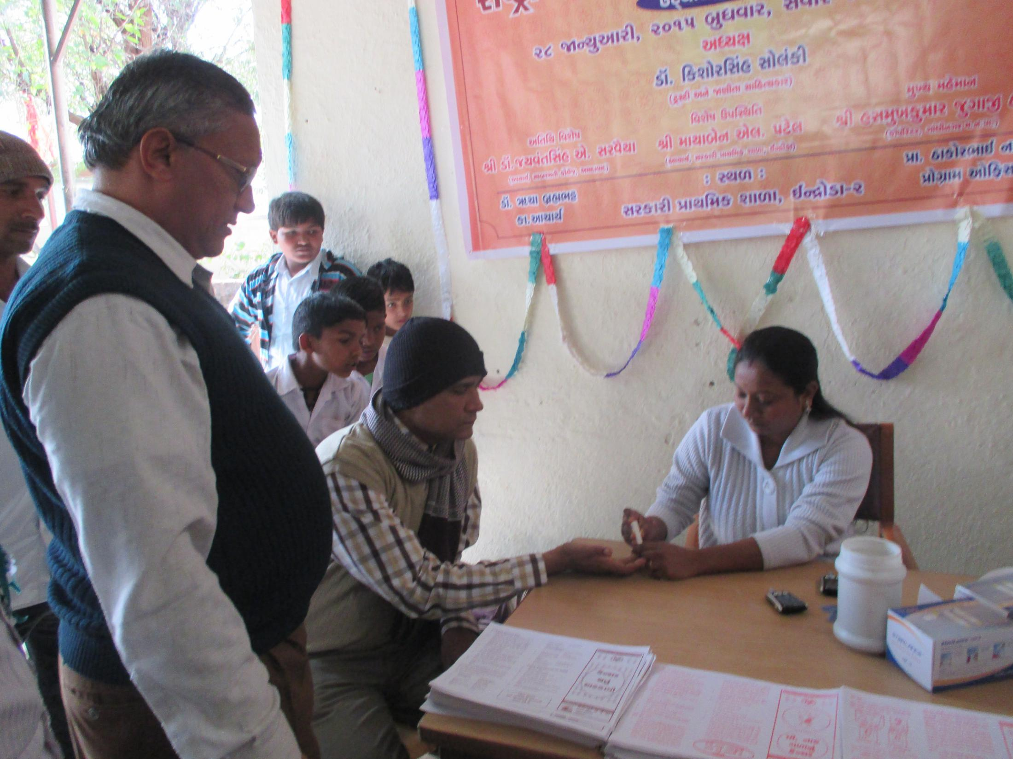
Health Checkup

Slide 3
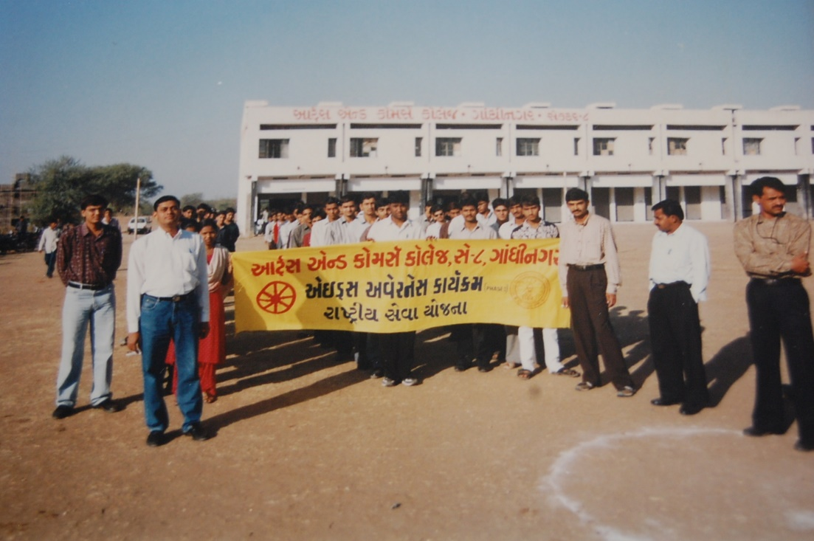
AIDS Awareness Drive

