Slide 1
Samarpan Website
Cultural Activities
1996 - 2018

Slide 2
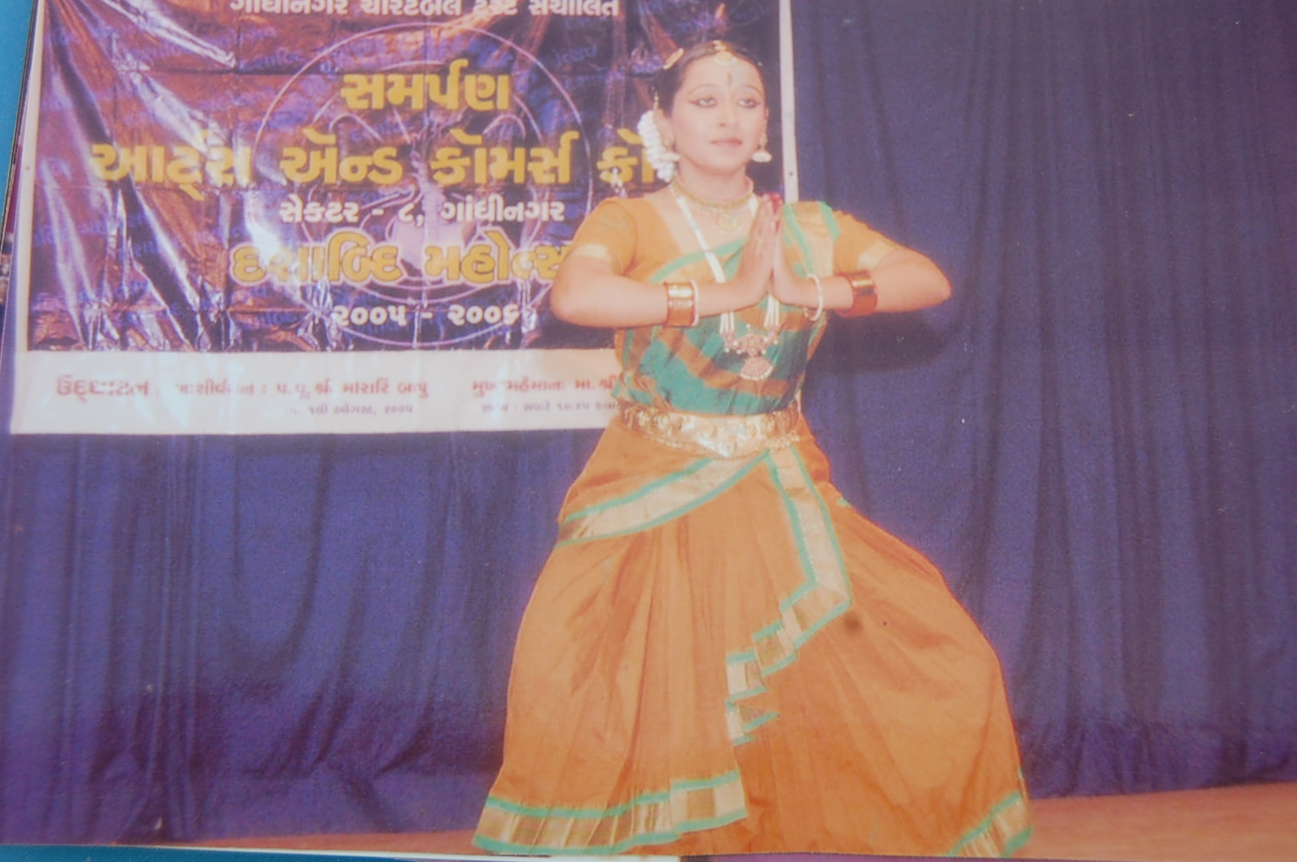
Classical Dance Performances

Slide 3
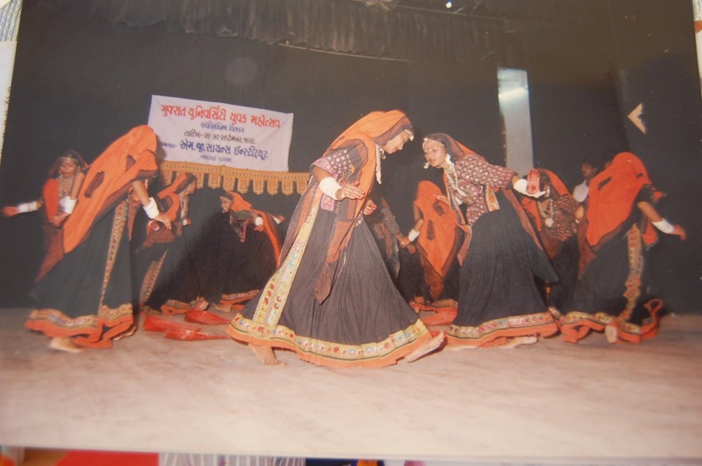
Dance Performances

Slide 4
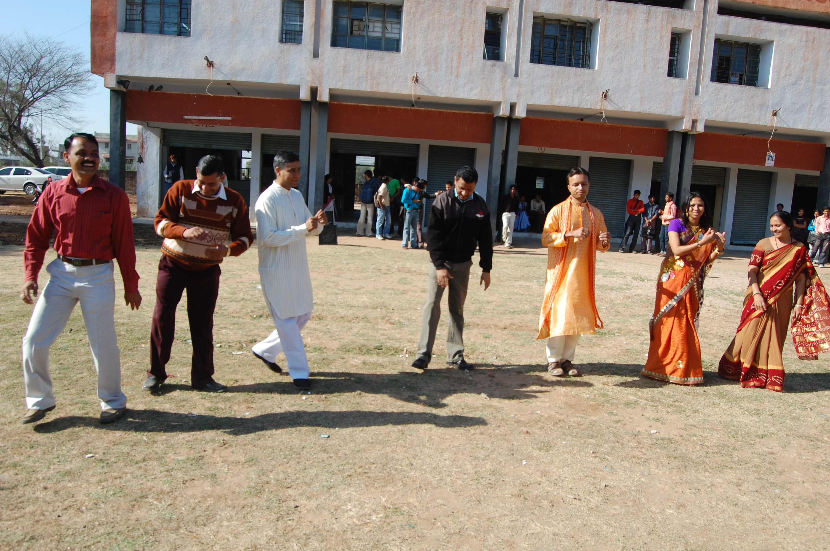
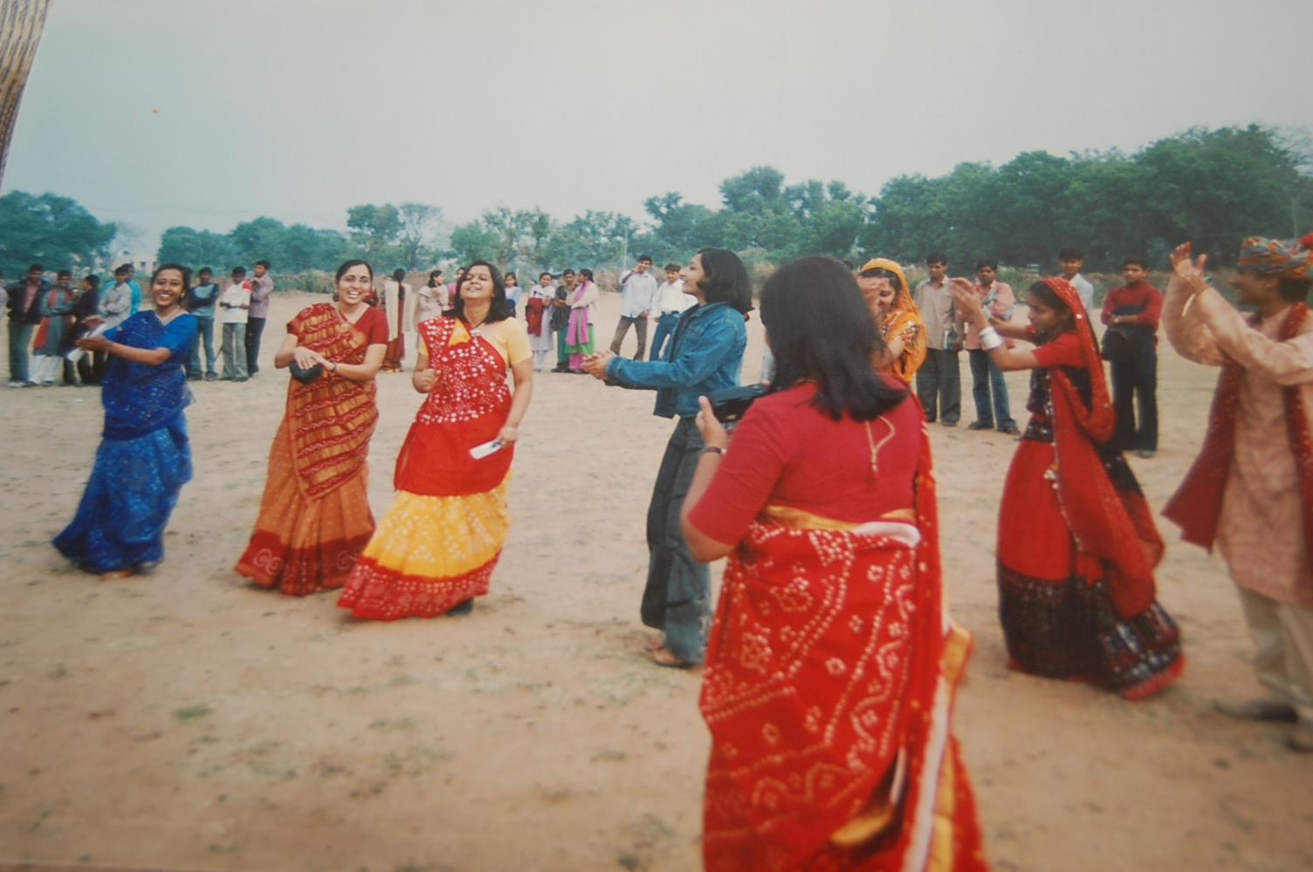
Garba

Slide 5
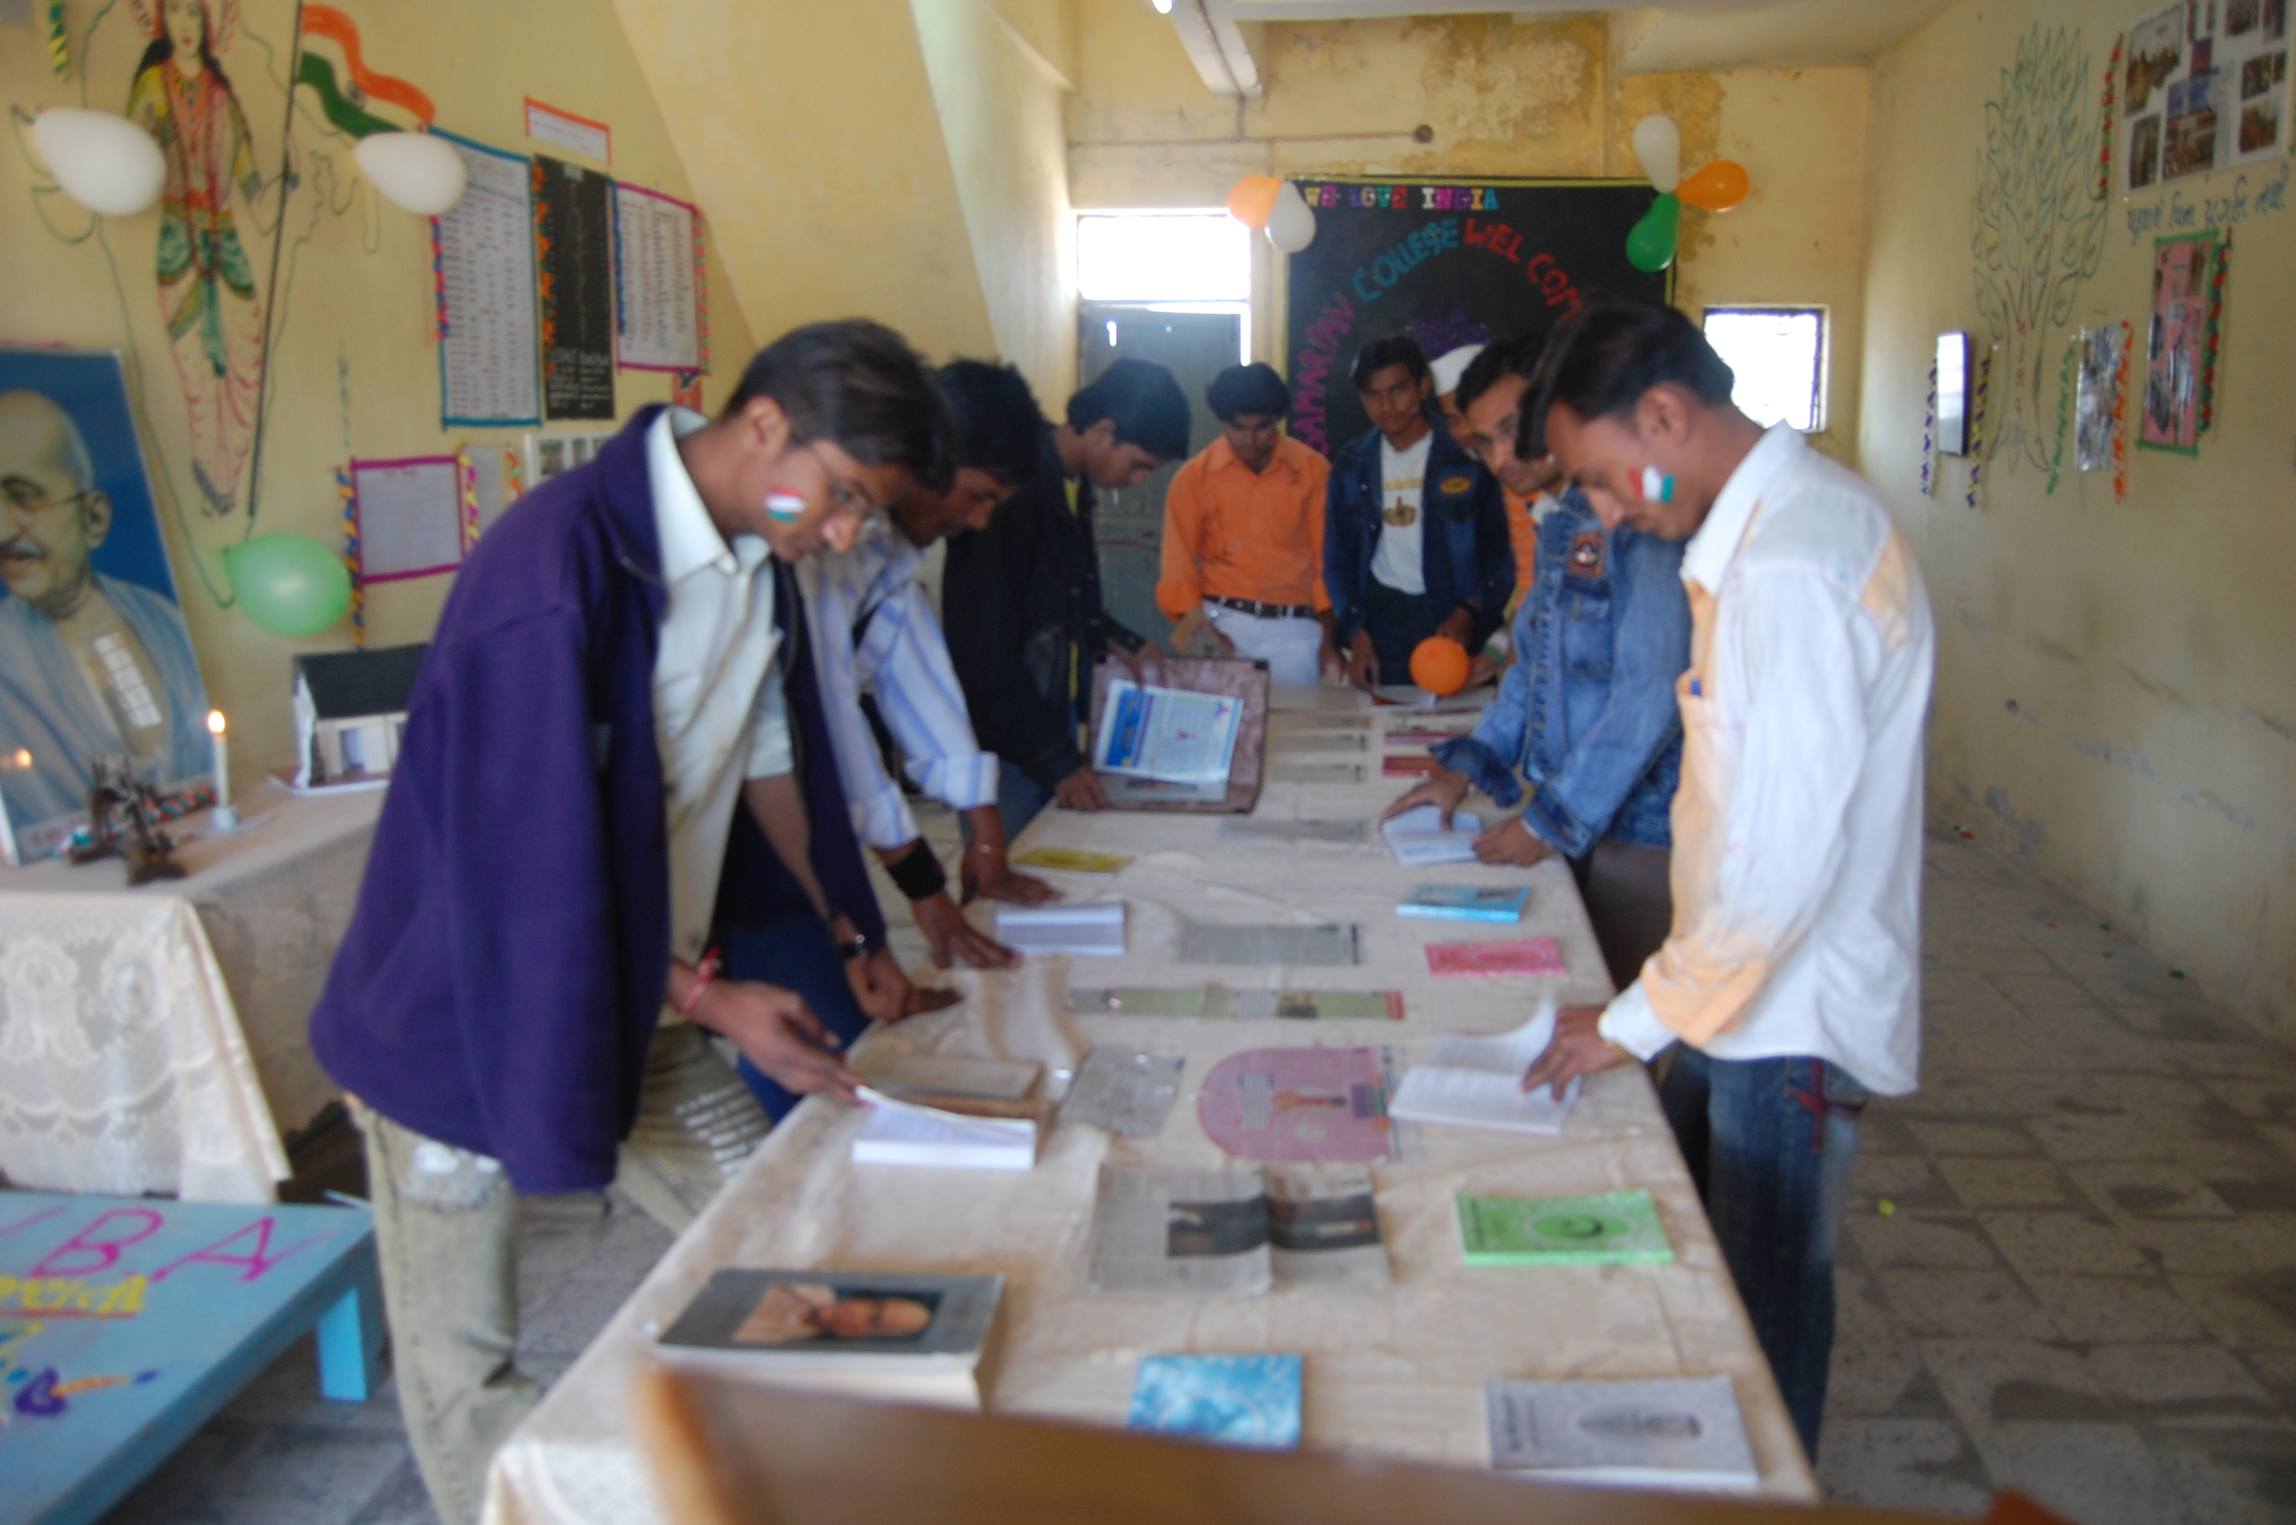
Celebration of Gandhi Jayanti

Slide 6
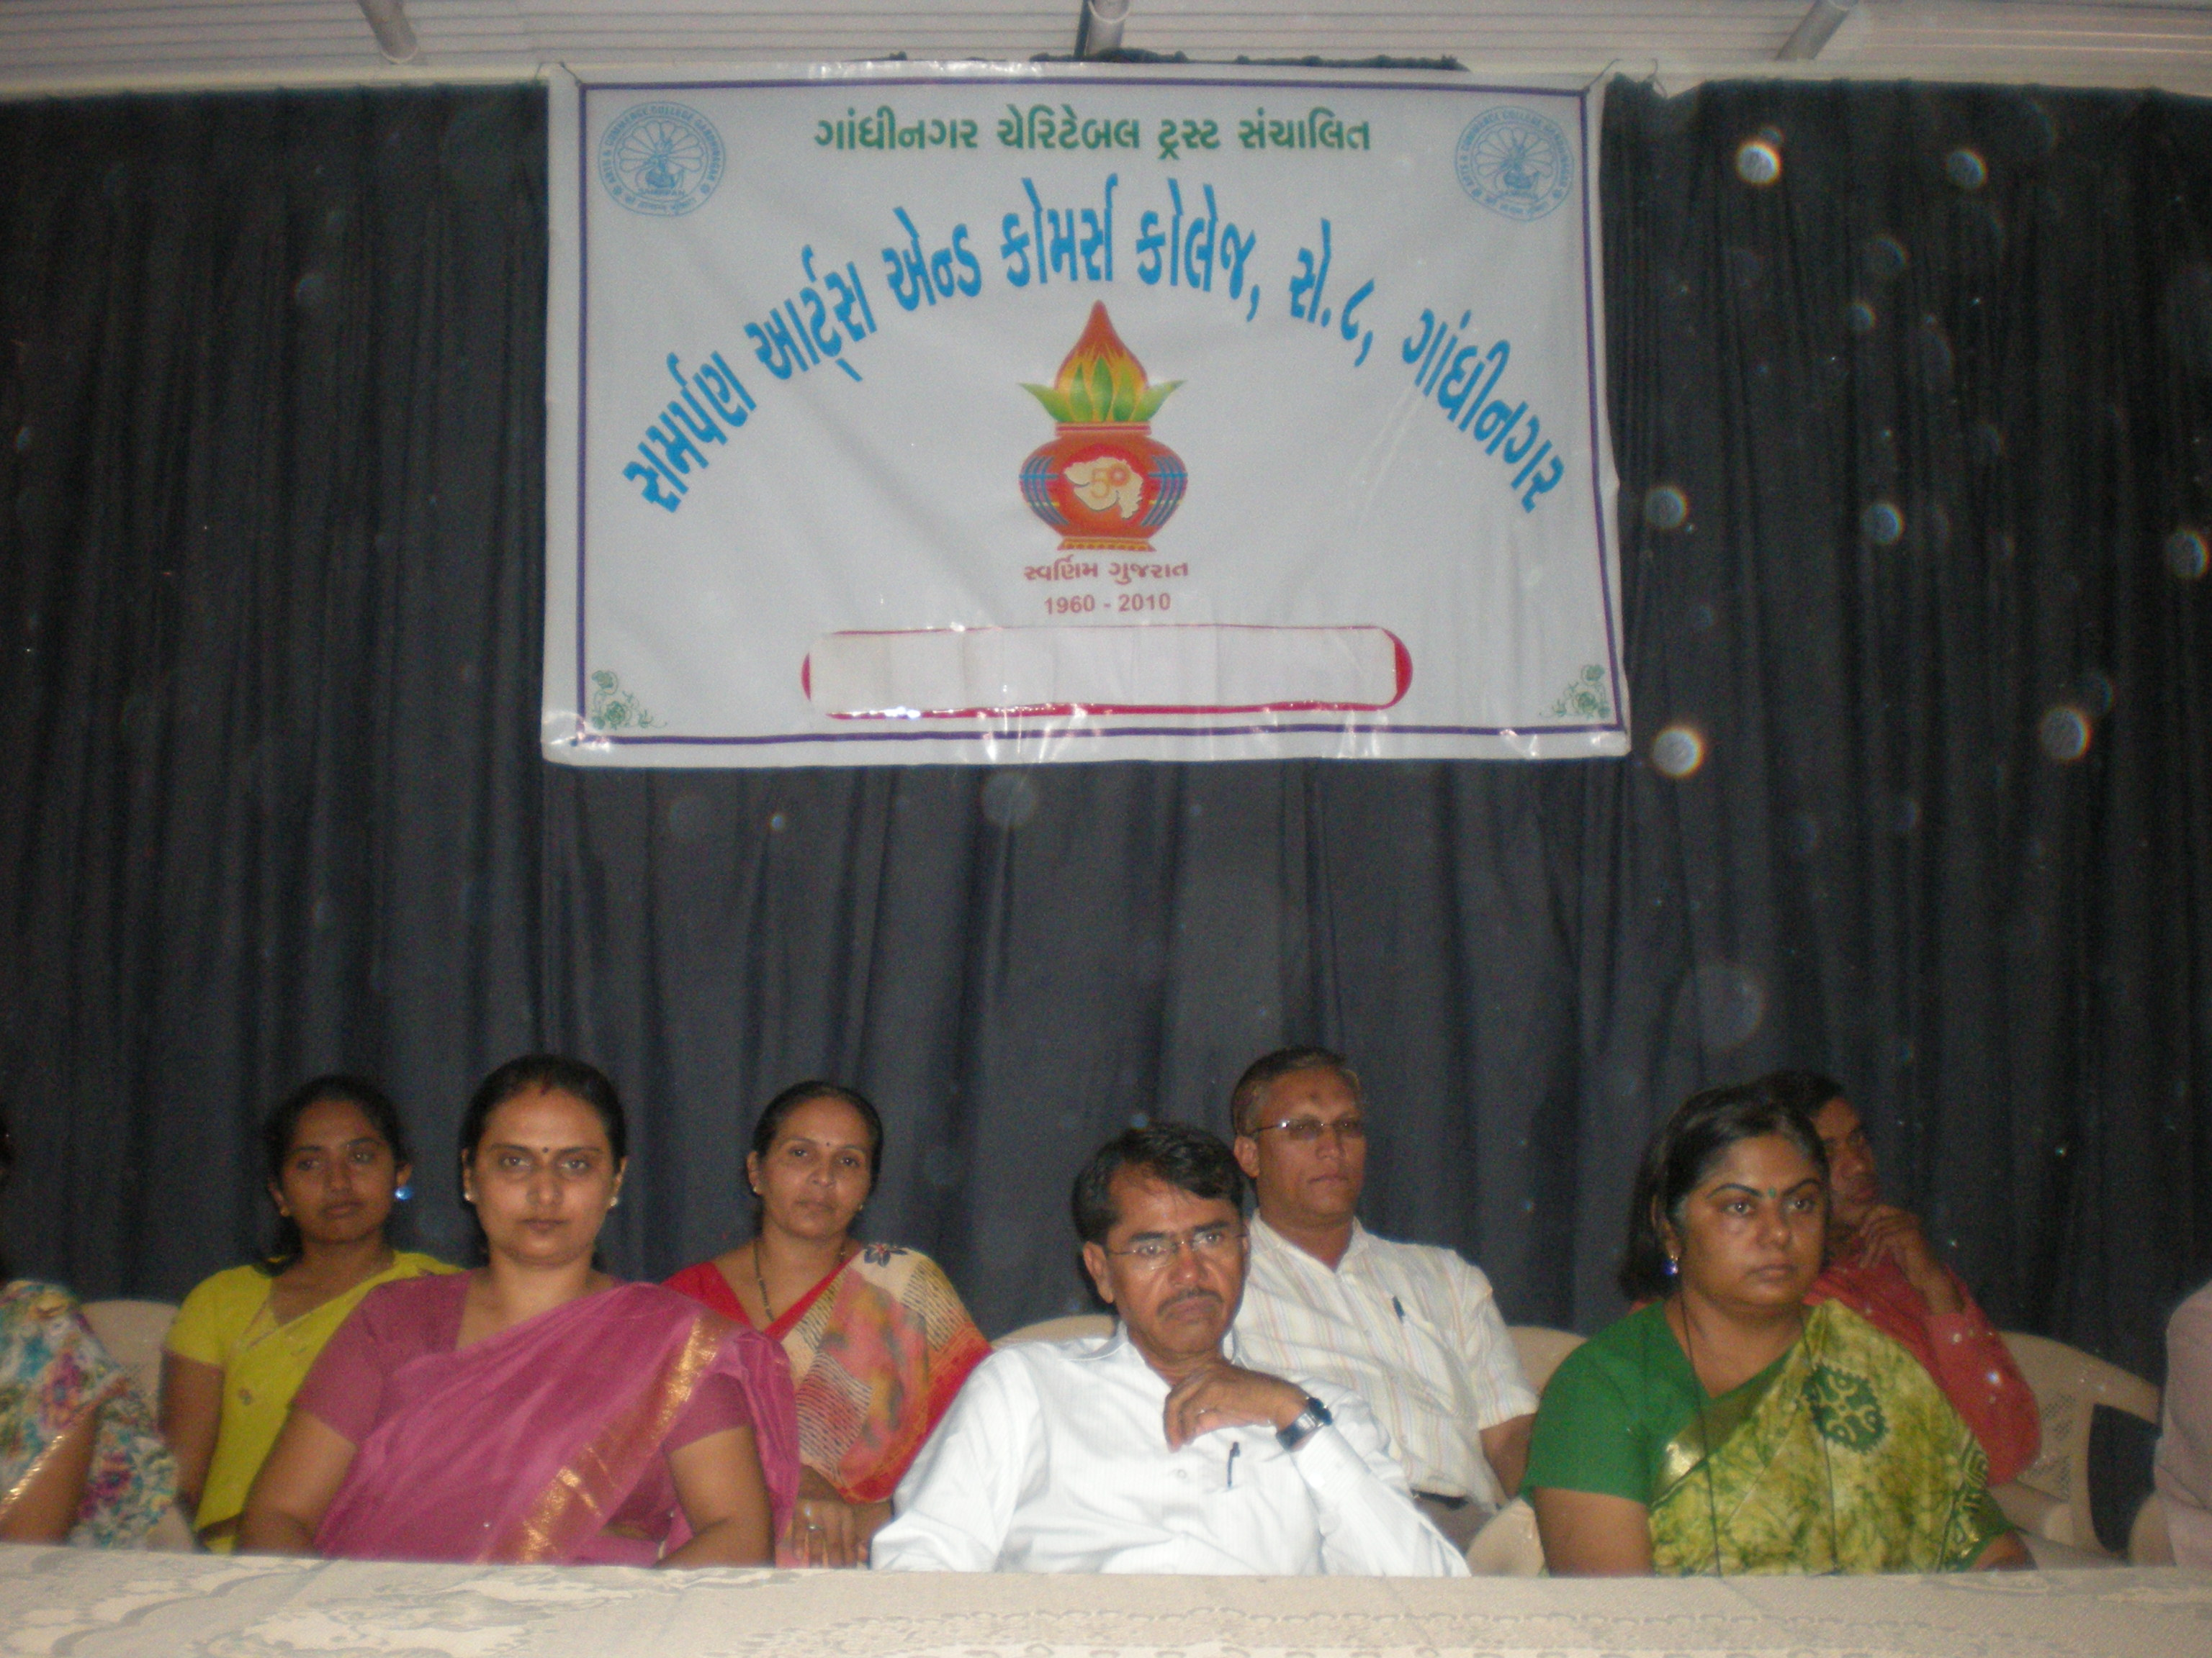
Observance of Martyr's Day and August Kranti Din

Slide 7
Celebration of 125th Birth Anniversary of Dr. B. R. Ambedkar

Slide 8
Sahitya Parv at the College

Slide 9
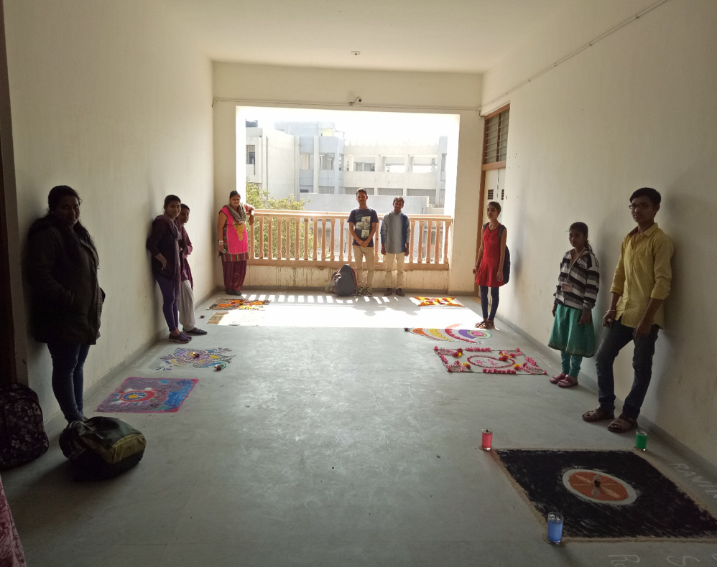
Cultural Activities - Rangoli

Slide 10
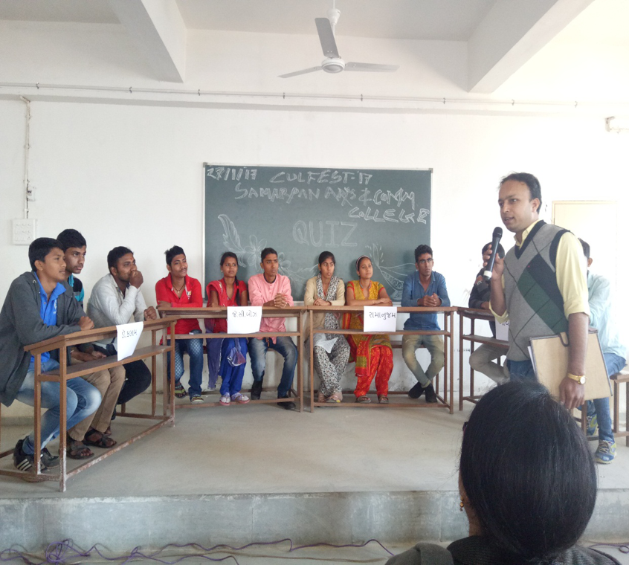
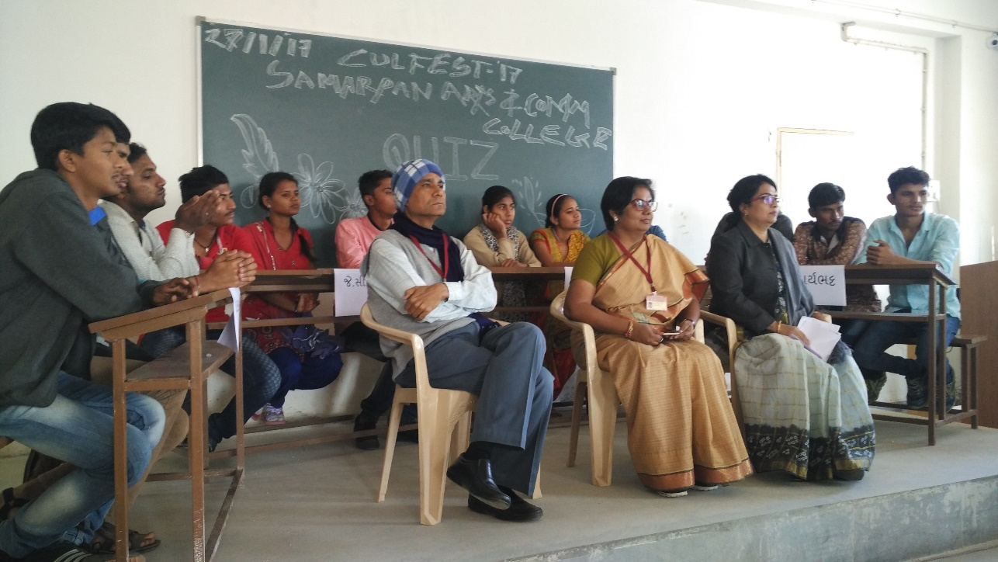
Cultural Activities - Quiz, Antakshari

Slide 11
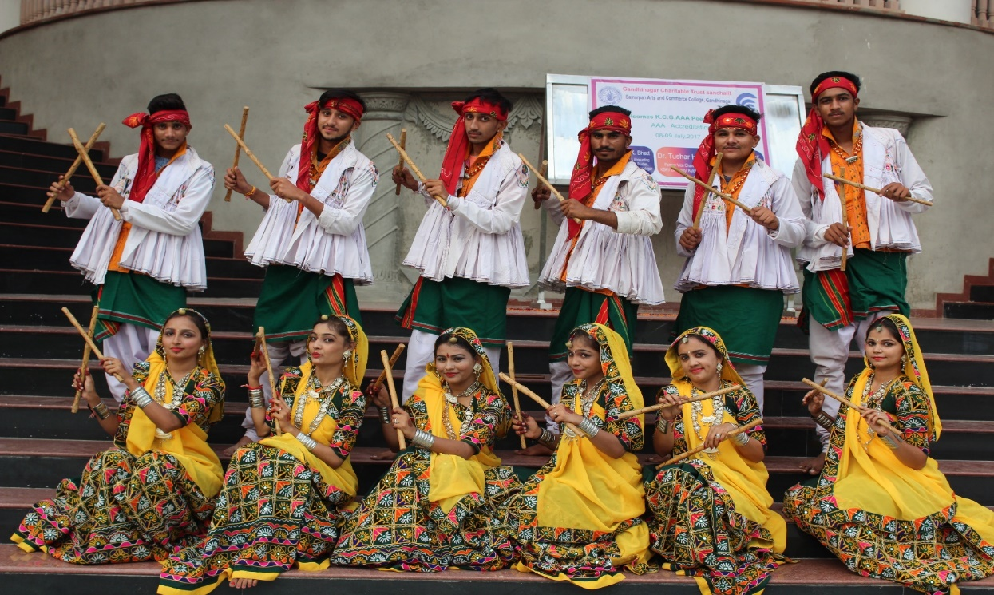
Cultural Performance at KCG AAA Peer Team Visit

