Slide 1
Samarpan Website
CWDC Activities
Till 2018

Slide 2
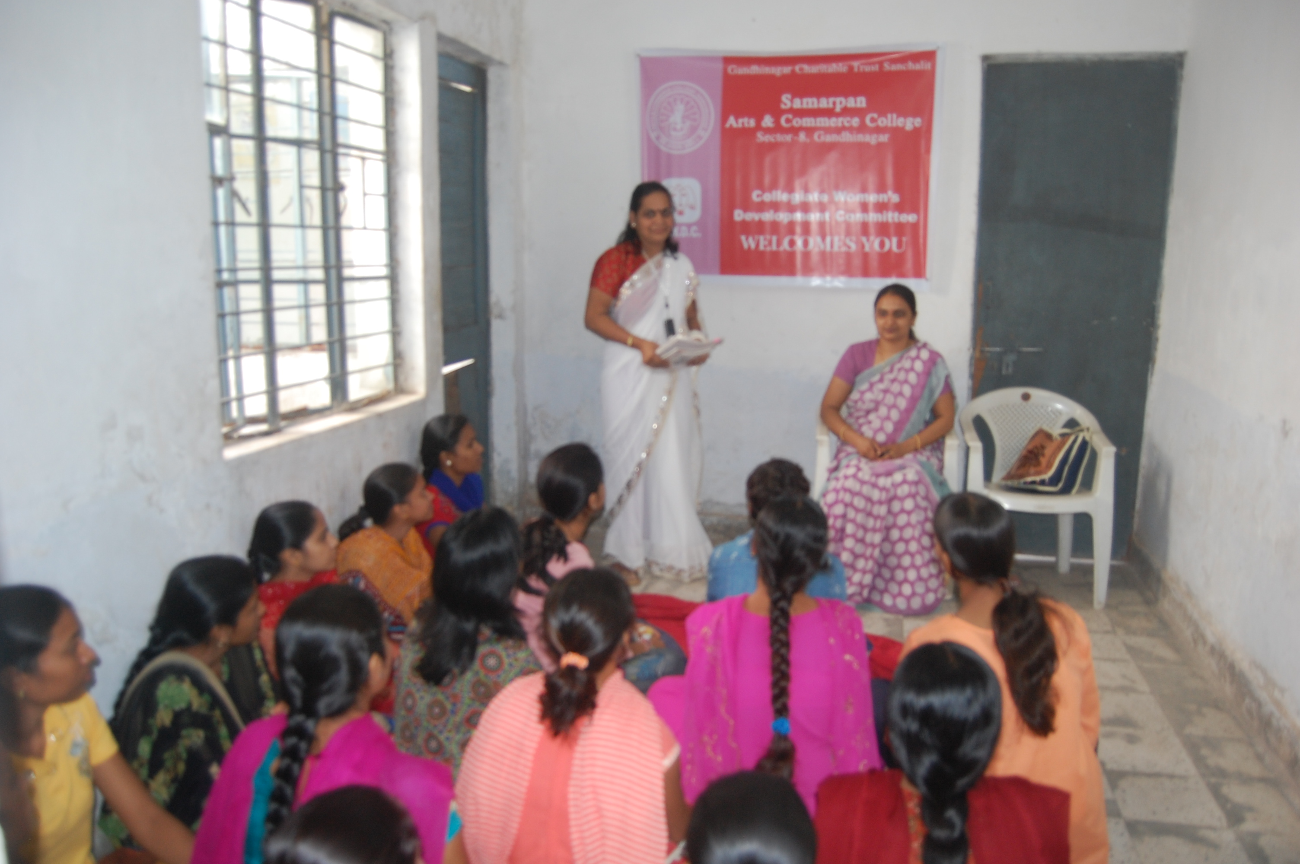
CWDC - Guest Lecture on Laws Related to Women
Notes:
Dr Sonalben Pandya, Siddharth Law College, Gandhinagar
Prof. Chhyaben Chavda, CWDC Coordinator

Slide 3
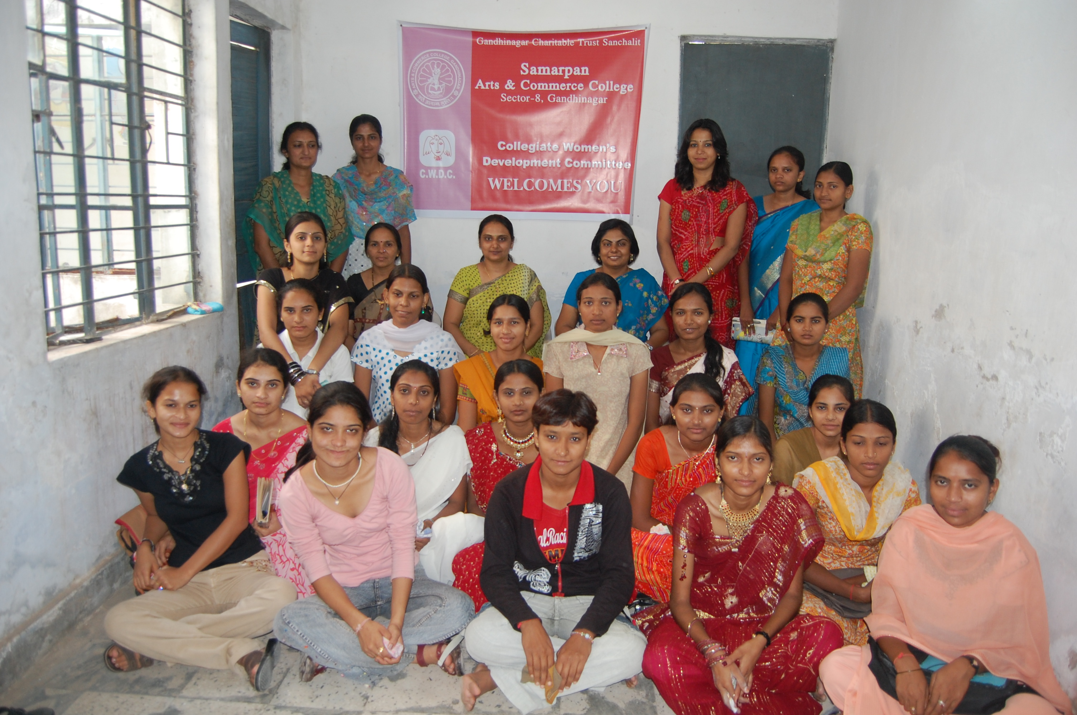
CWDC Orientation

Slide 4
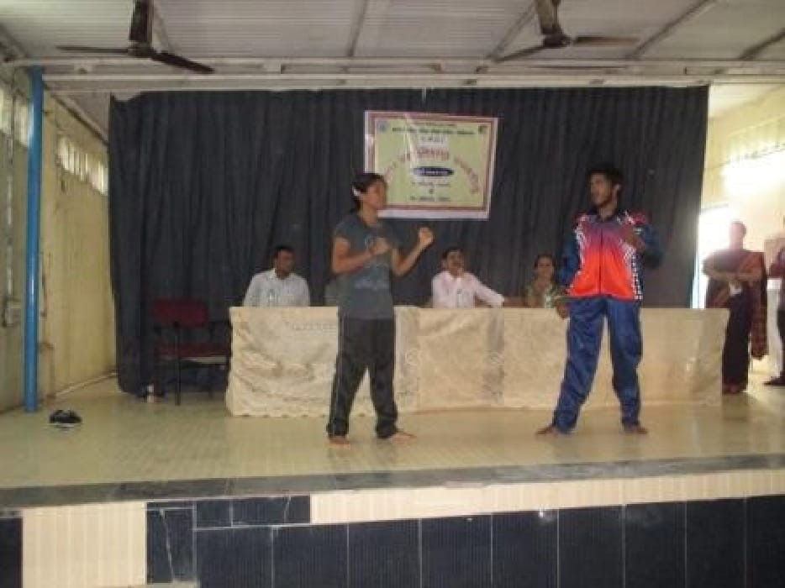
Training in Self Defence

