Slide 1
Samarpan Website
Annual Days
1996 to 2018

Slide 2
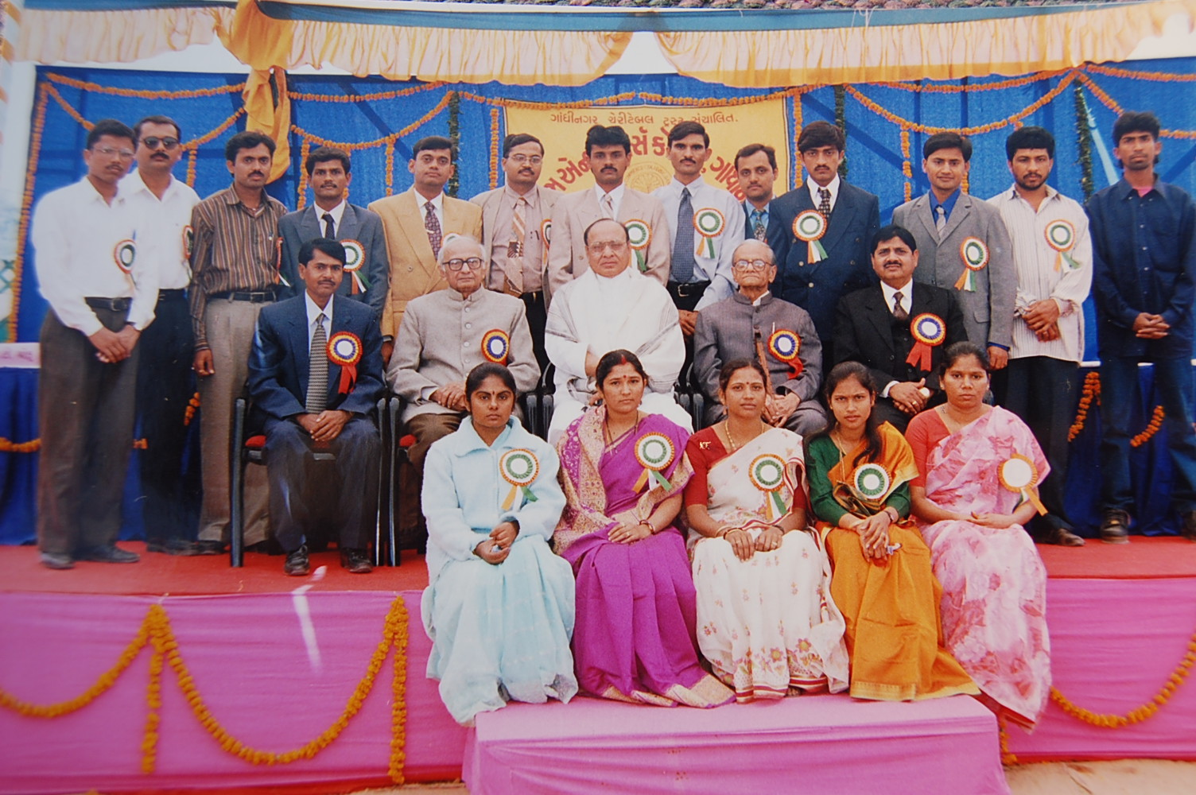
Annual Days
Notes:
Shri Shankersinh Vaghela Bapu, Shri Kulinchandra Yagnik, Shri Dhirubhai Thakar, Dr Kishorsinh Solanki with Staff members (1999)

Slide 3
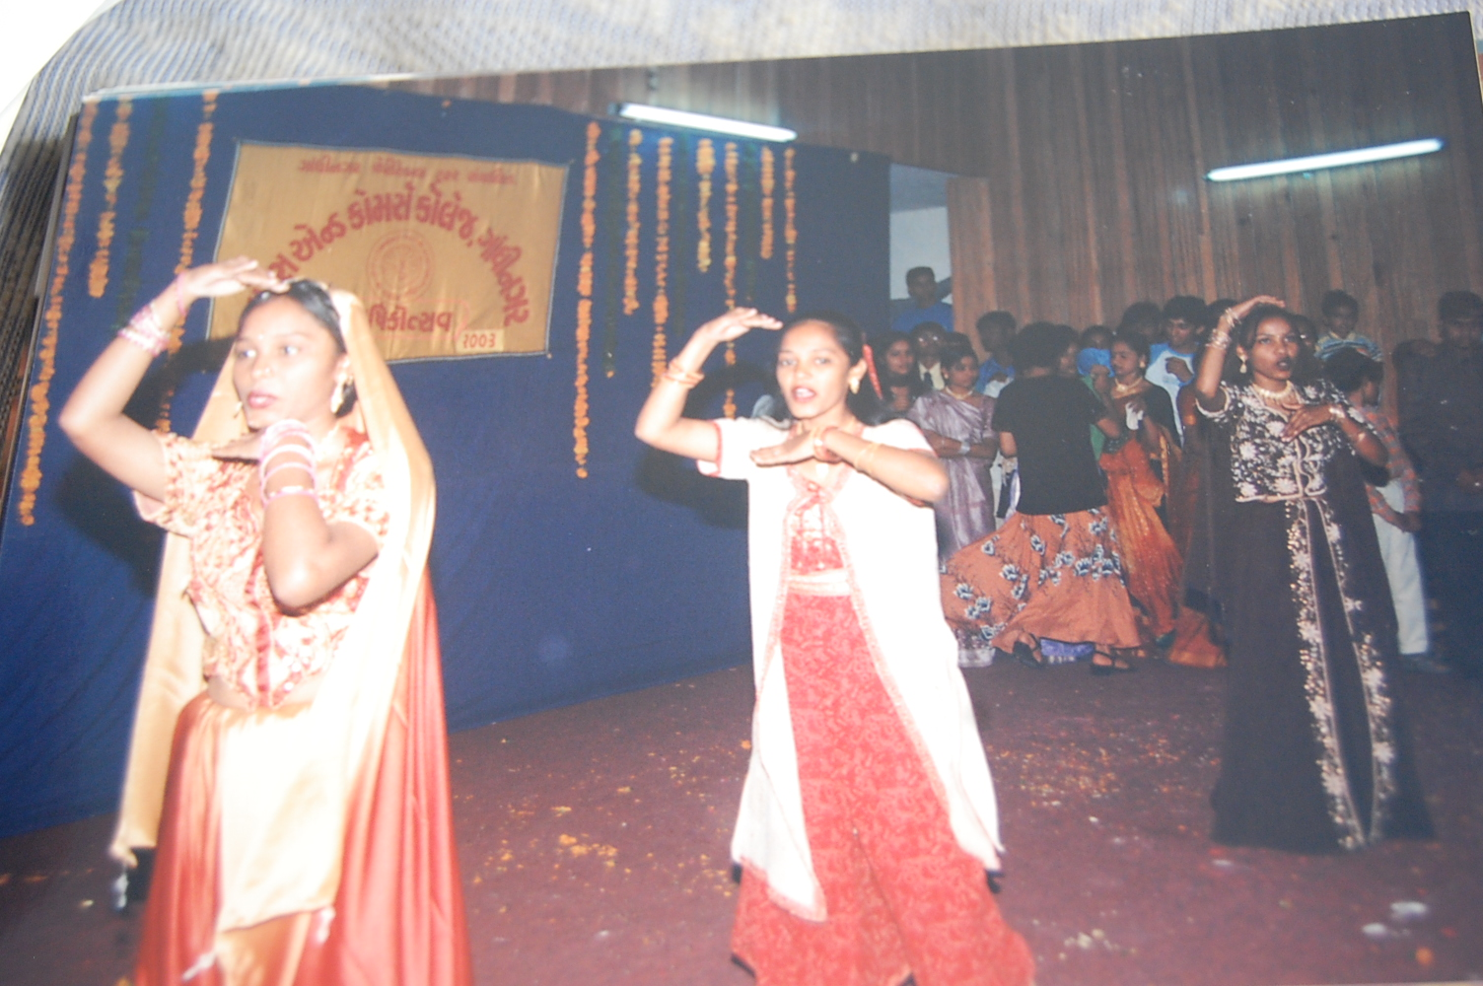
Annual Days
Notes:
Prof. K. S. Shastri

Slide 4
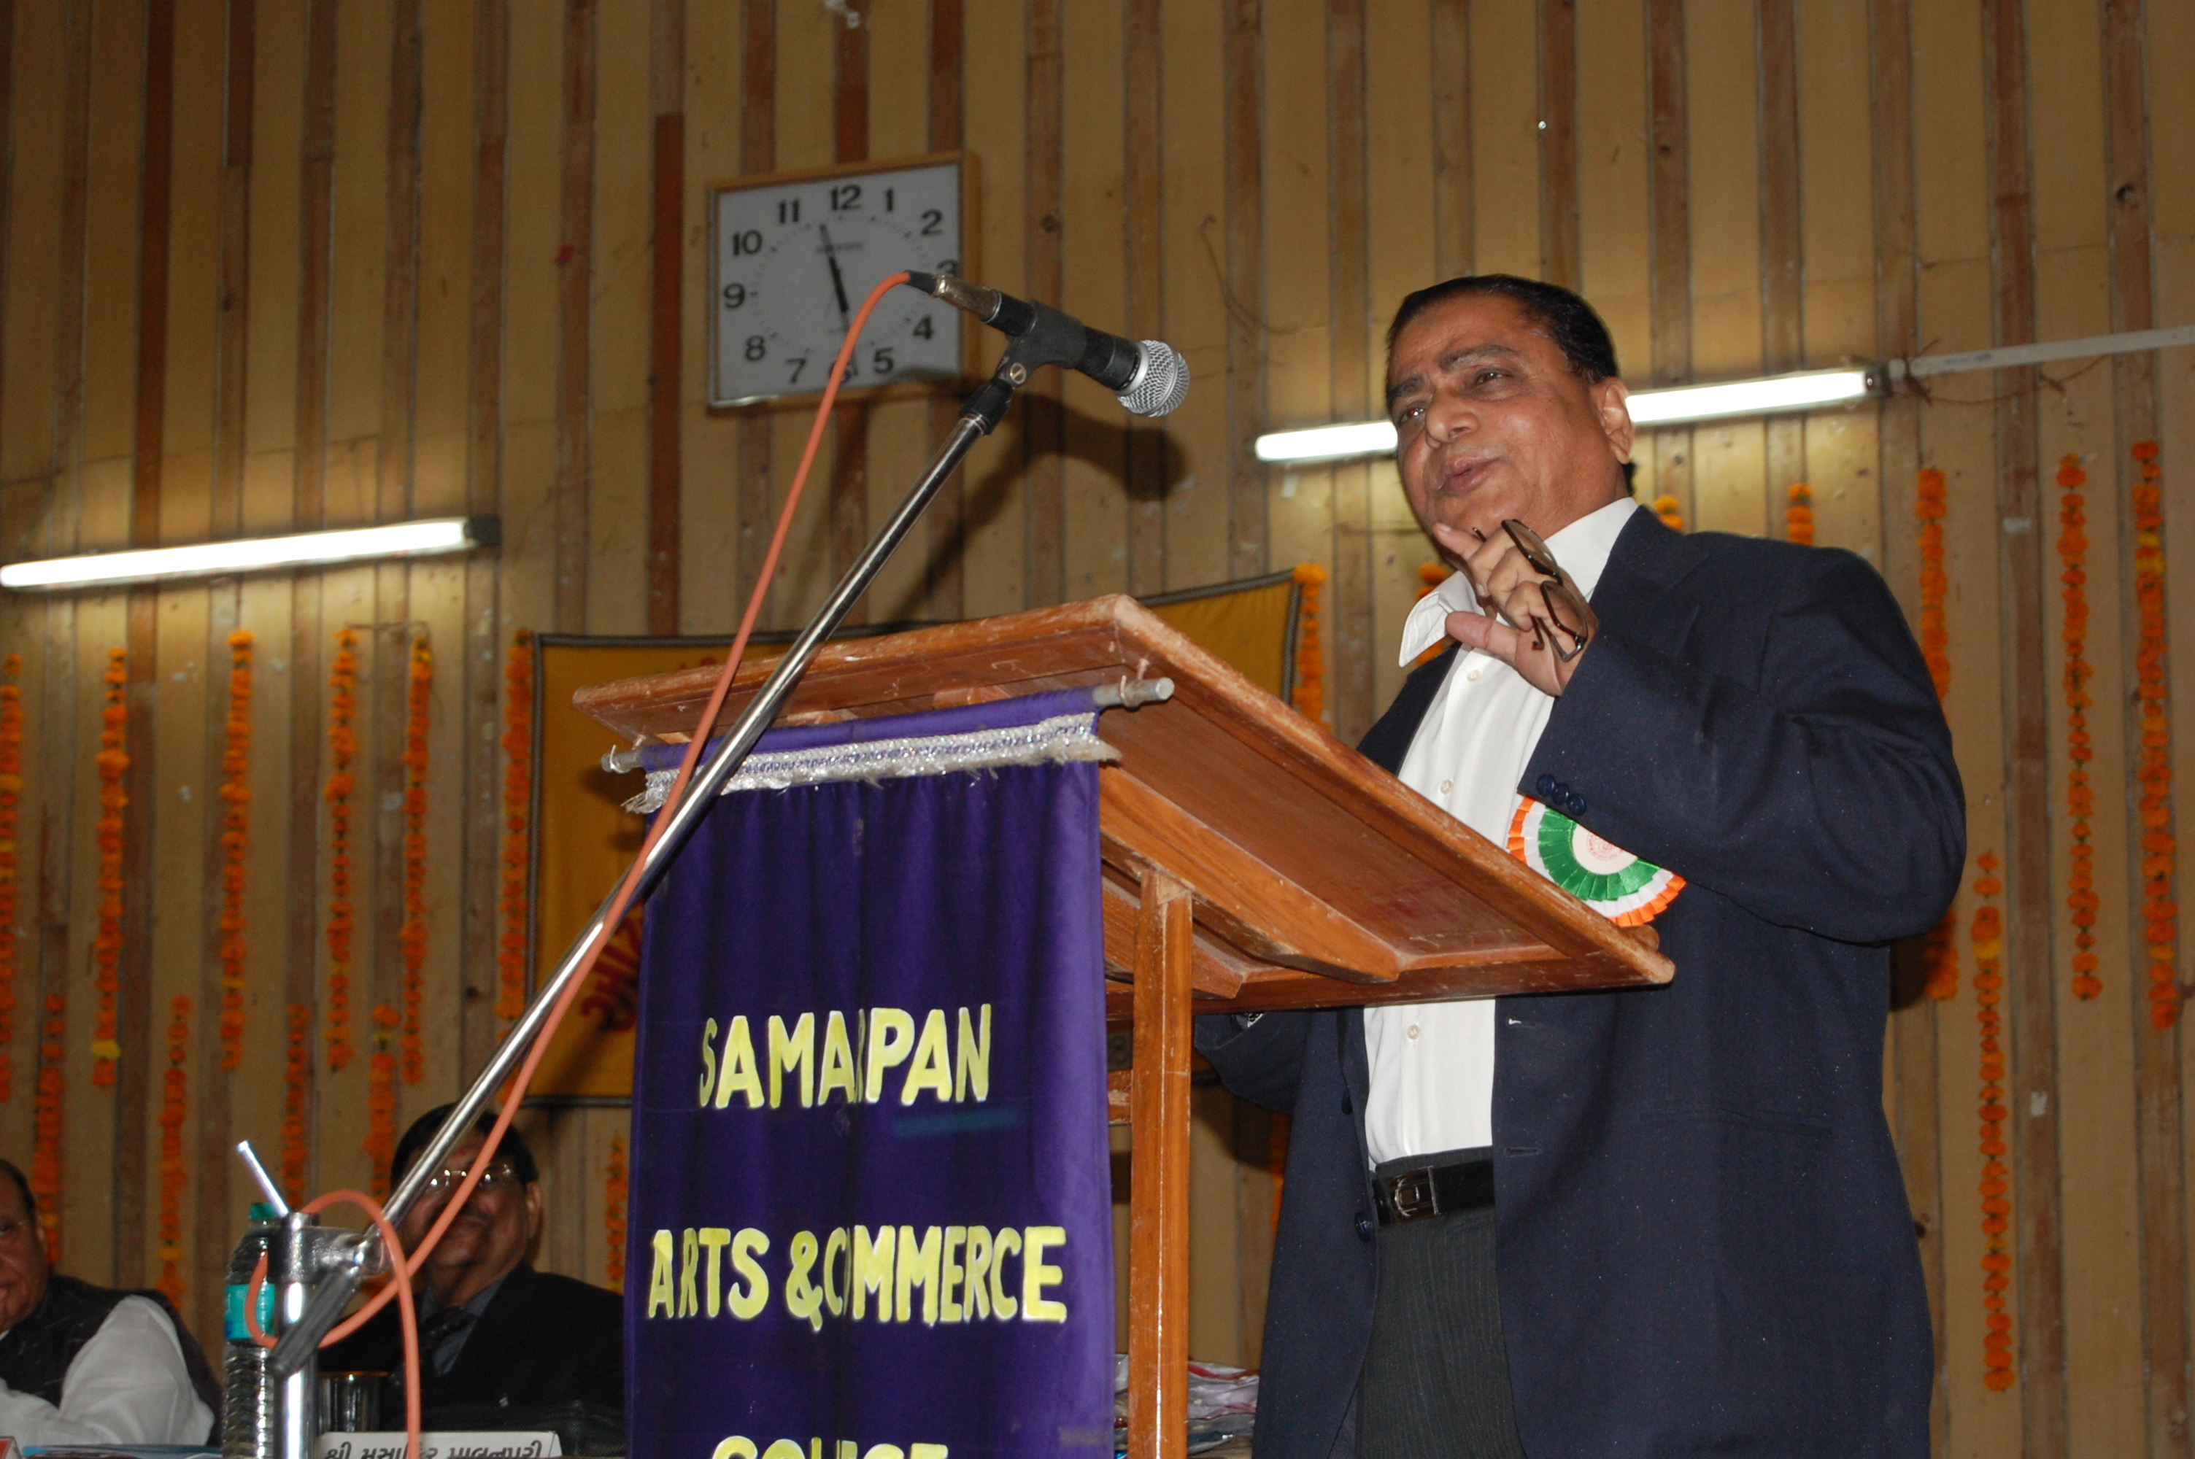
Annual Days
Notes:
Shri Musafir Palanpuri, Gujarati poet

